Slide 1

Active Contour External Force Using Vector Field Convolution for Image Segmentation
By Bing Li and Scott T. Acton
Oral presentation
Paumier Nicolas & This Alexandre
Introduction to medical imaging

Slide 2
Active contours : Goal

Slide 3
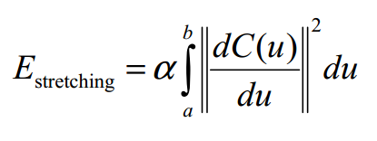
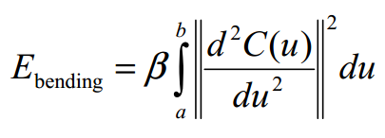
Active contours – Energy minimisation Internal energy

Slide 4
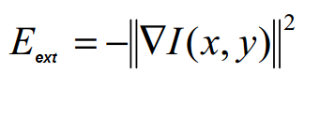
Active contours – Energy minimisation External energy

Slide 5
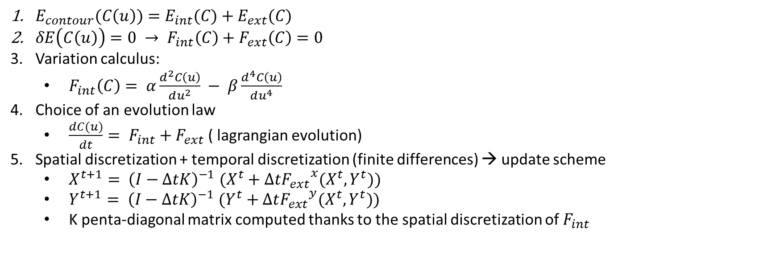
Active contours : Update scheme
$E_{contour}(C\left(u\right))=E_{int}(C)+E_{ext}(C)$
$δE\left(C\left(u\right)\right)=0 → F_{int}\left(C\right)+F_{ext}\left(C\right)=0$
Variation calculus:
$F_{int}\left(C\right)= α\frac{d^{2}C\left(u\right)}{du^{2}} − β\frac{d^{4}C\left(u\right)}{du^{4}}$
Choice of an evolution law
$\frac{dC(u)}{dt}= F_{int}+F_{ext}$ ( lagrangian evolution)
Spatial discretization + temporal discretization (finite differences) → update scheme
$X^{t+1}{= \left(I−ΔtK\right)}^{−1}(X^{t}+Δt{F_{ext}}^{x}(X^{t},Y^{t}))$
$Y^{t+1}{= \left(I−ΔtK\right)}^{−1}(Y^{t}+Δt{F_{ext}}^{y}(X^{t},Y^{t}))$
K penta-diagonal matrix computed thanks to the spatial discretization of $F_{int}$

Slide 6
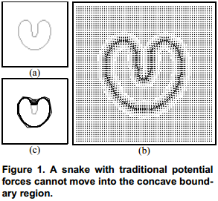
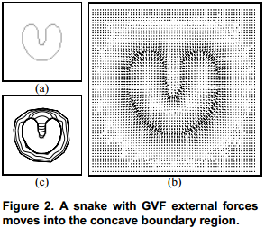
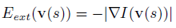
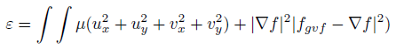
External force using Gradient Vector Flow
Traditional external energy : difficulty with concavities
New potential field
minimizing :
Drawbacks
High computational cost
Sensibility to noise and parameters
Unclear relation between capture range and parameters
Credit Xu & Prince

Slide 7
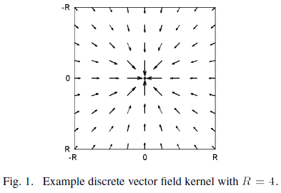
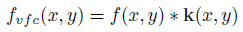
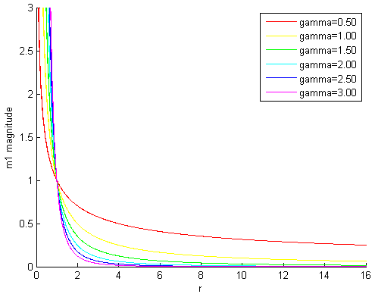
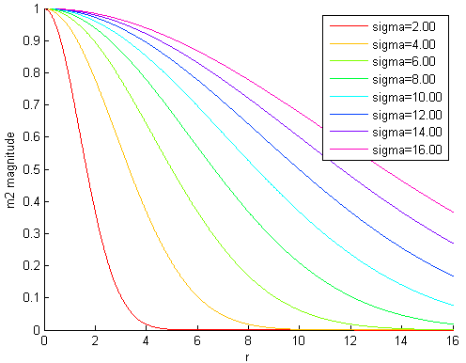
External Force using Vector Field Convolution
GVF :
VFC :
with
Advantages
Speed up computation
Controllability
Generality

Slide 8
Analysis of active contours using VFC
Claims :
Large capture range
Better robustness to noise
Convergence in concavities
Good behavior on initialisation
Reduced computational costs
Variation of VFC parameters
Comparison with GVF for impulse and additive gaussian noise
Test of the behavior with respect to concavities
Test of multiple initialisation

Slide 9
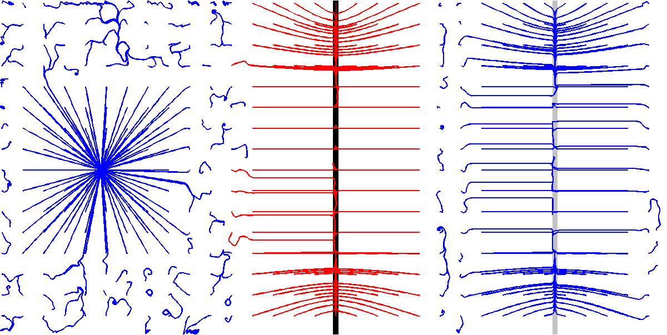
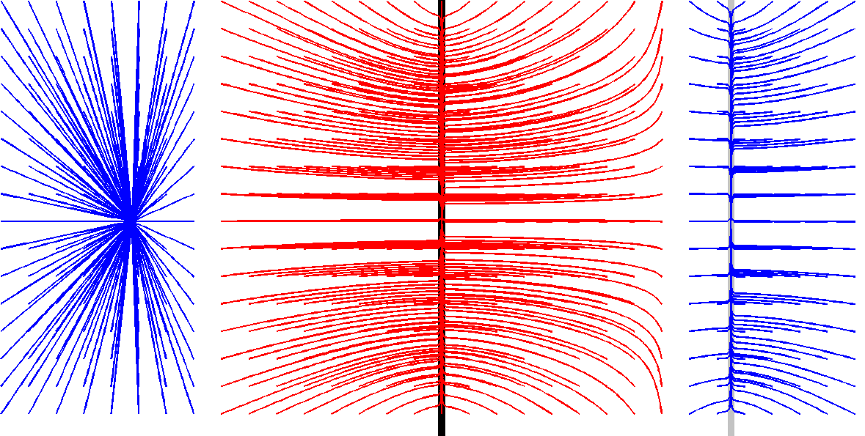
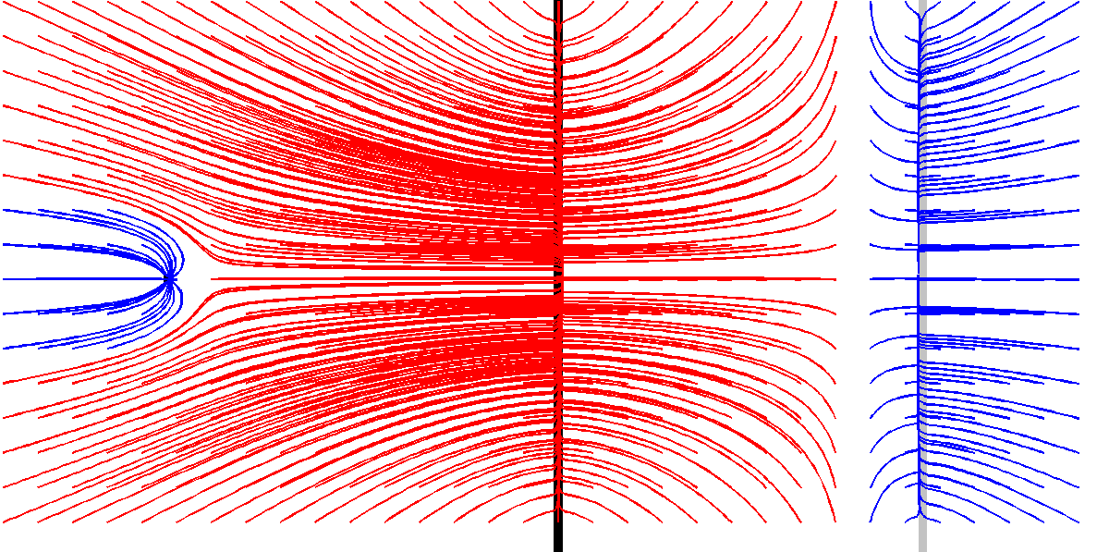
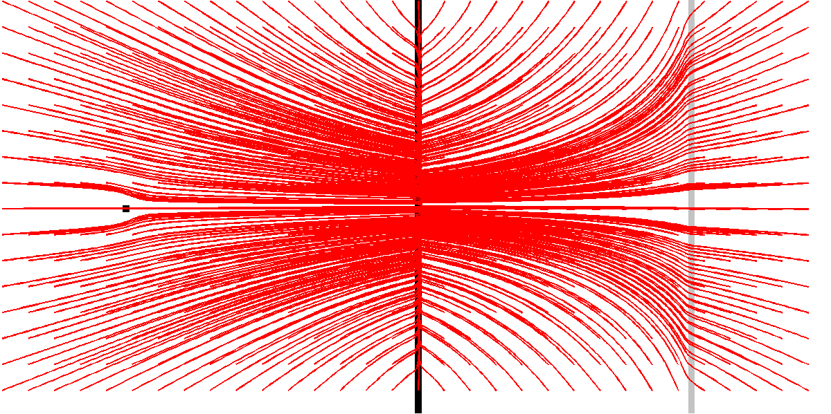
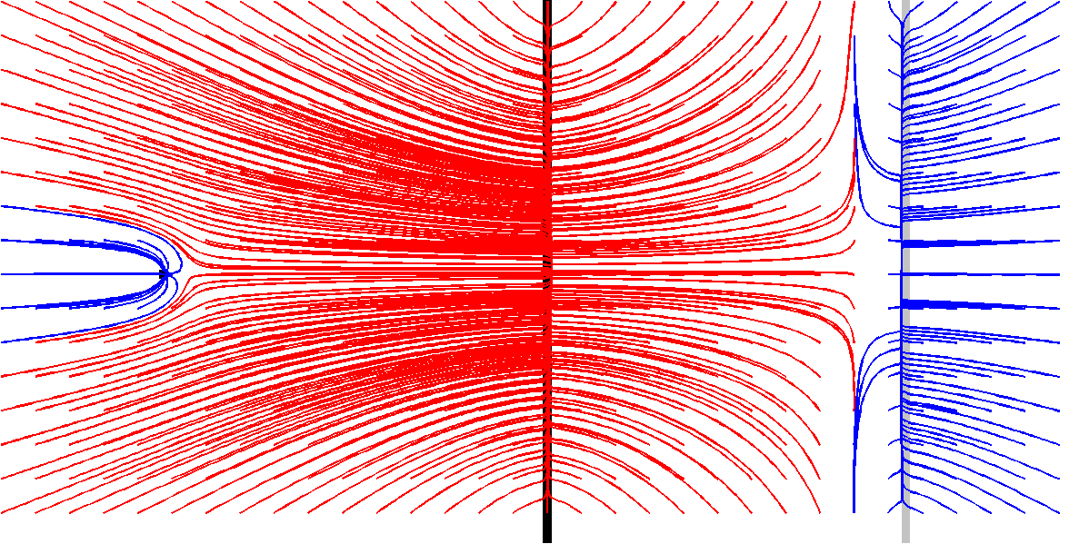
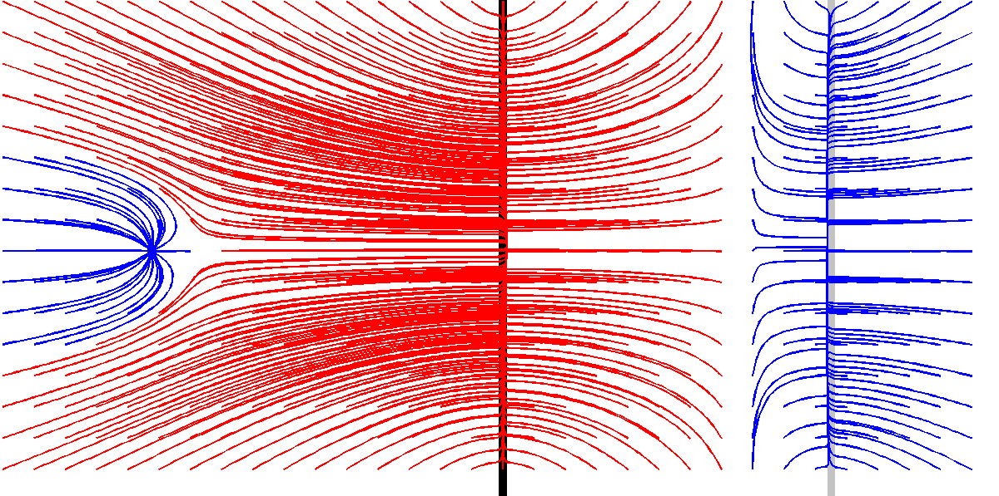
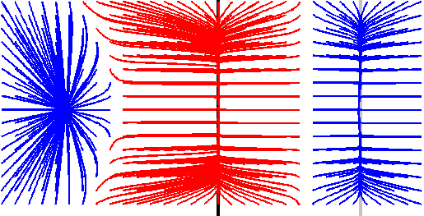
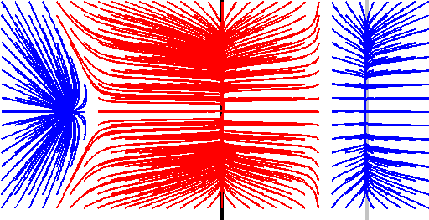
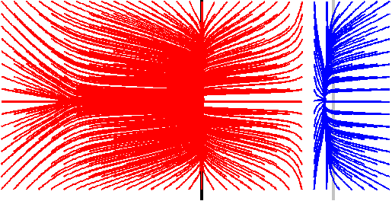
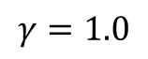
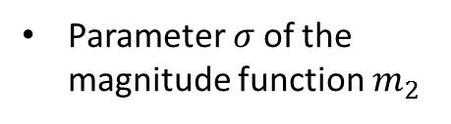
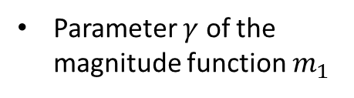
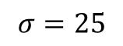
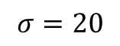
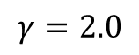
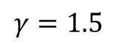
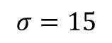
VFC Parameters
Size R of the convolution kernel
R = 16
R = 32
R = 64
Parameter $γ$ of the magnitude function $m_{1}$
$$γ=1.0$$
$$γ=1.5$$
$$γ=2.0$$
Parameter $σ$of the magnitude function $m_{2}$
$$σ=15$$
$$σ=20$$
$$σ=25$$

Slide 10
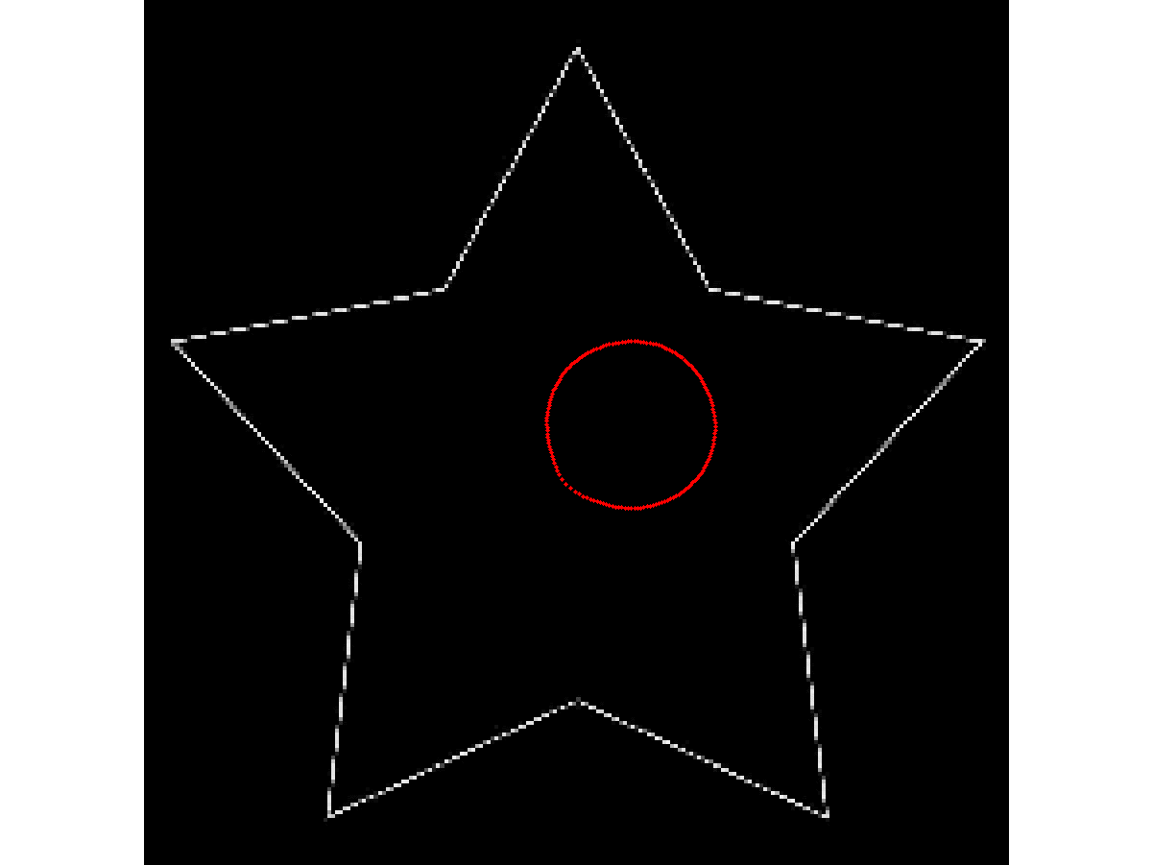
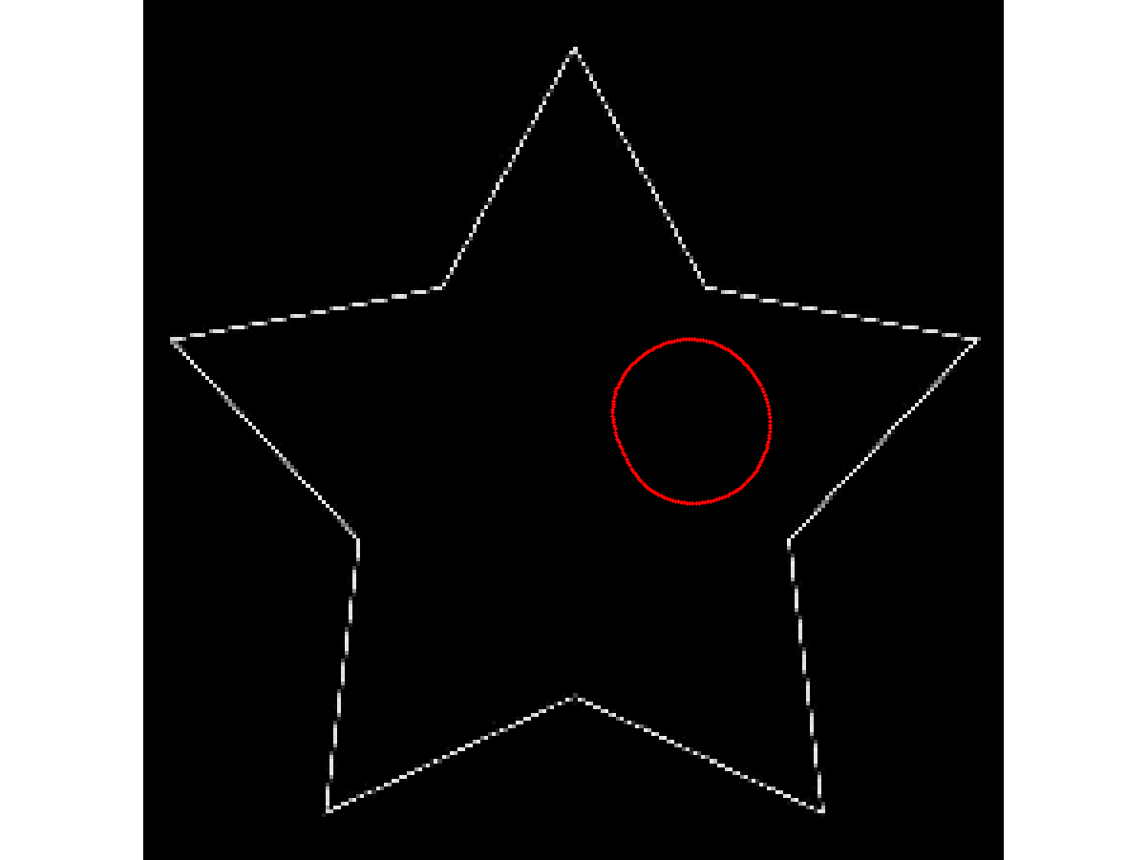
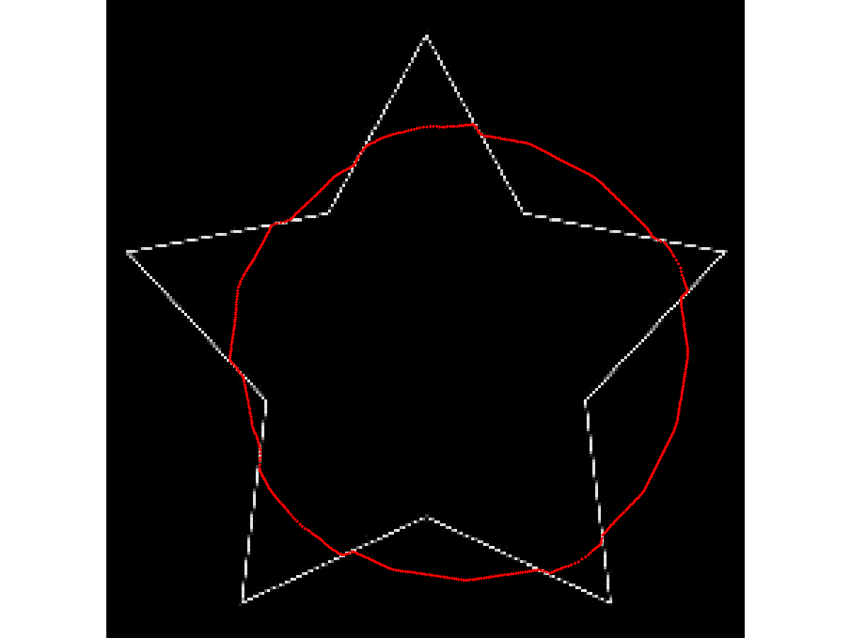
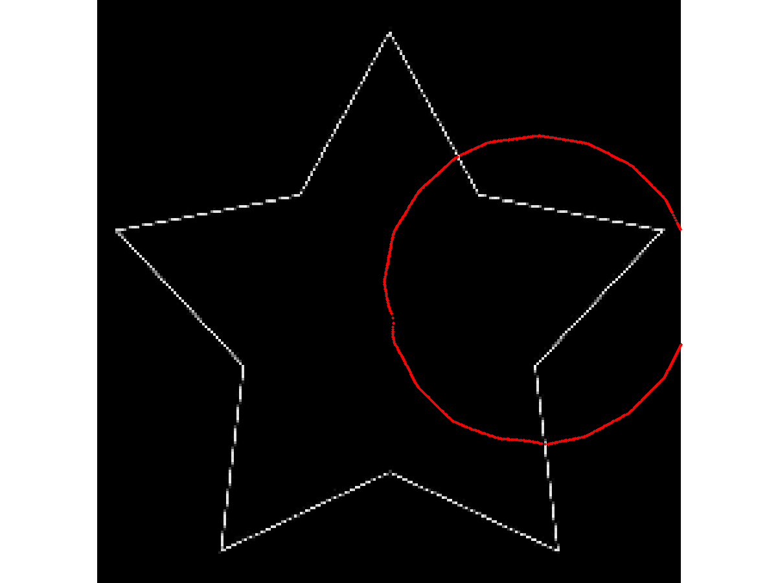
Robustness to contour initialisation

Slide 11
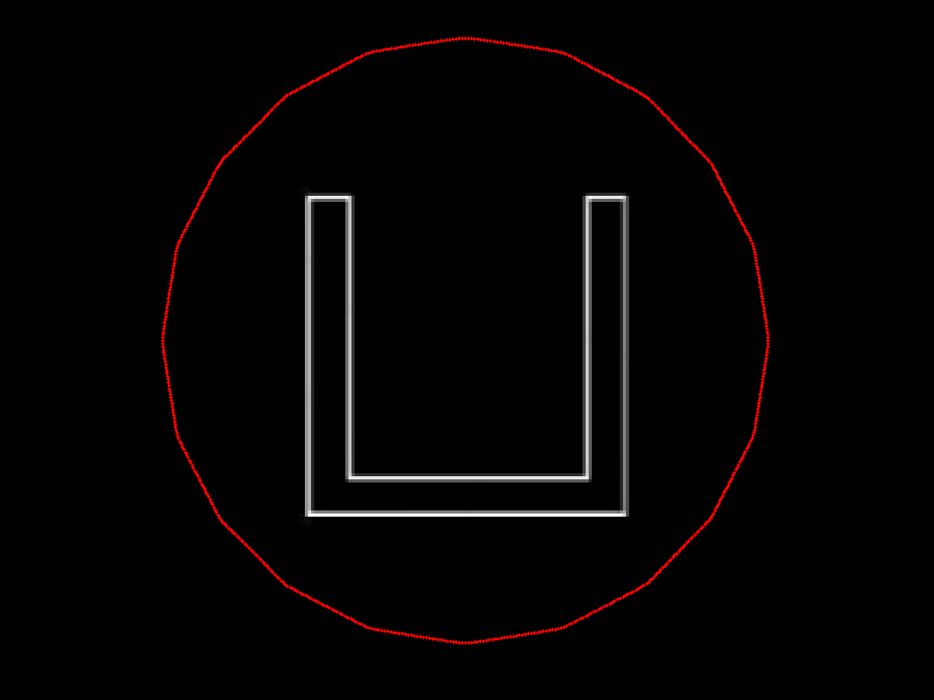
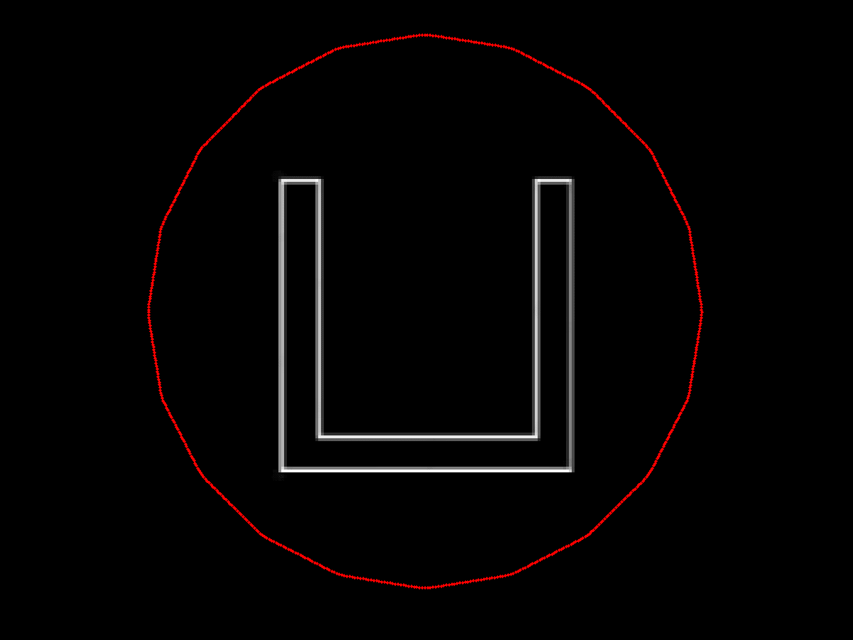
Convergence to concavities (1/2)
GVF
VFC

Slide 12
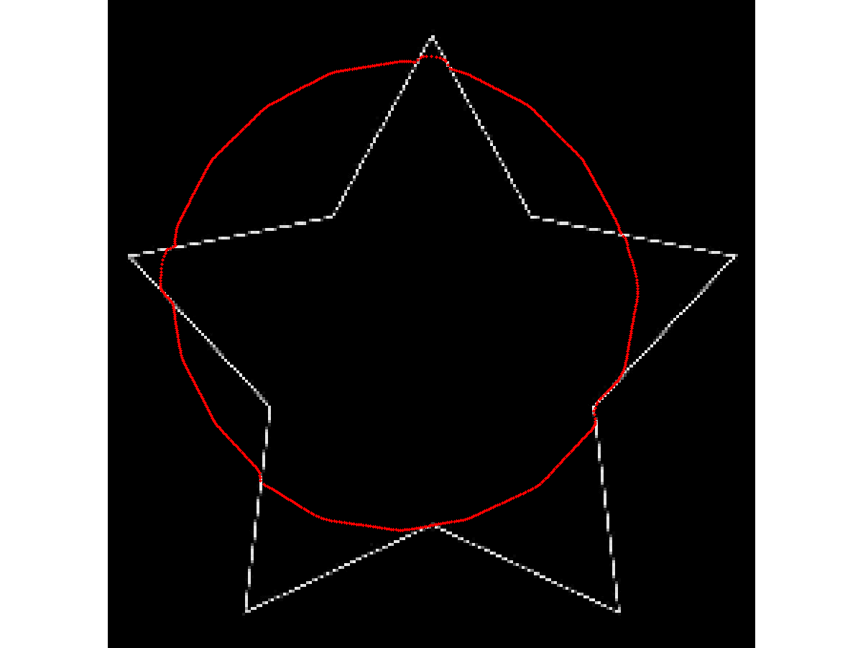
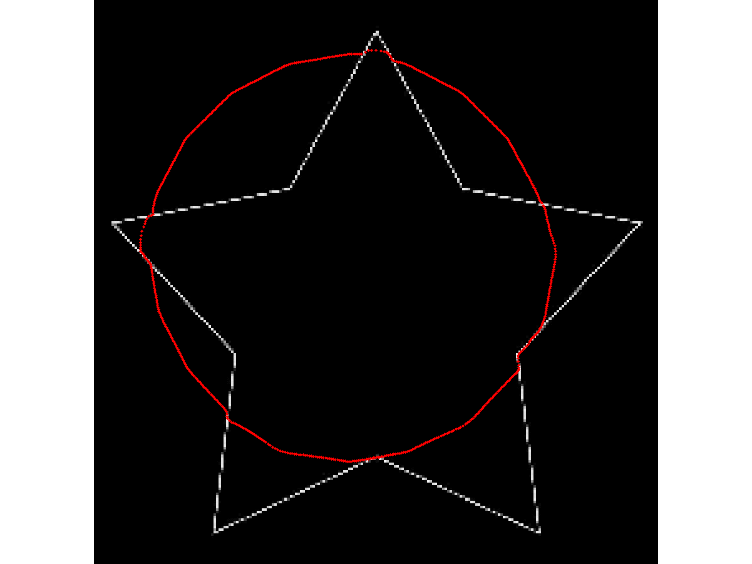
Convergence to concavities (2/2)
GVF
VFC

Slide 13
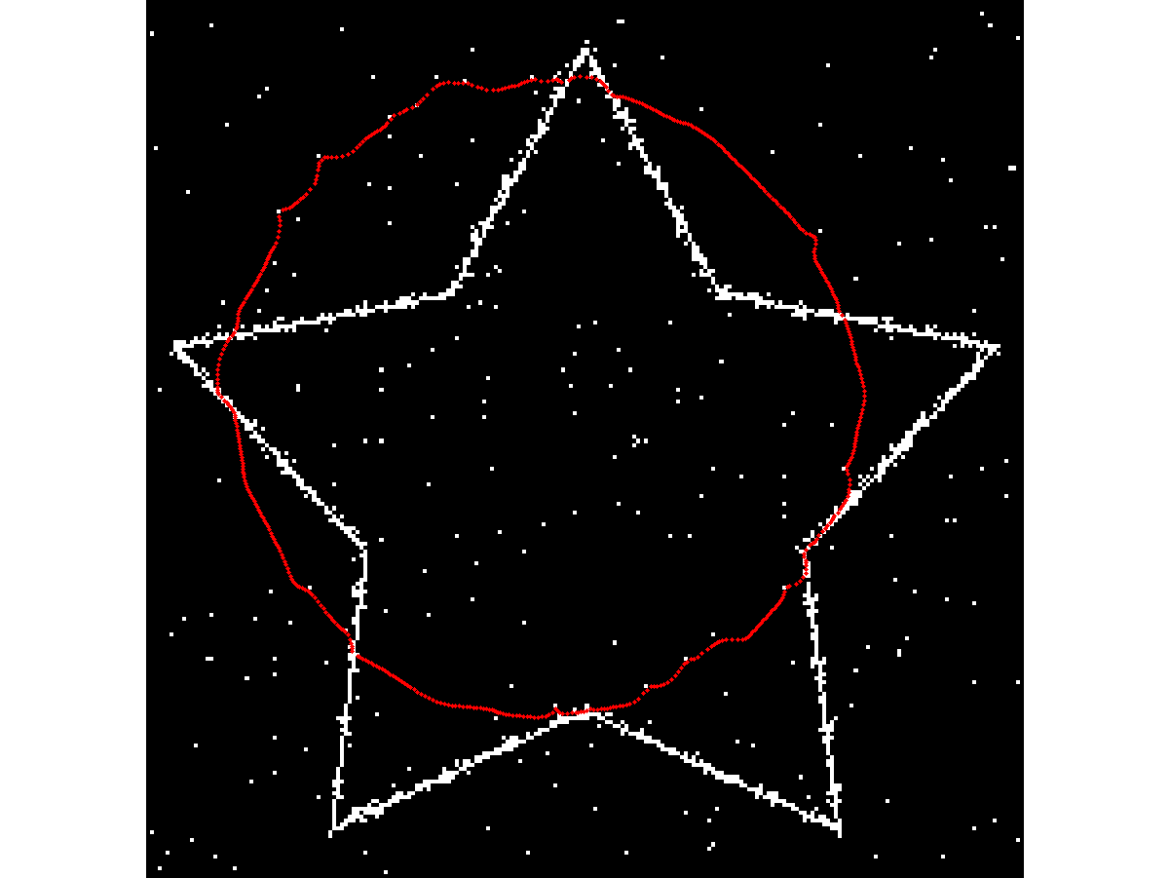
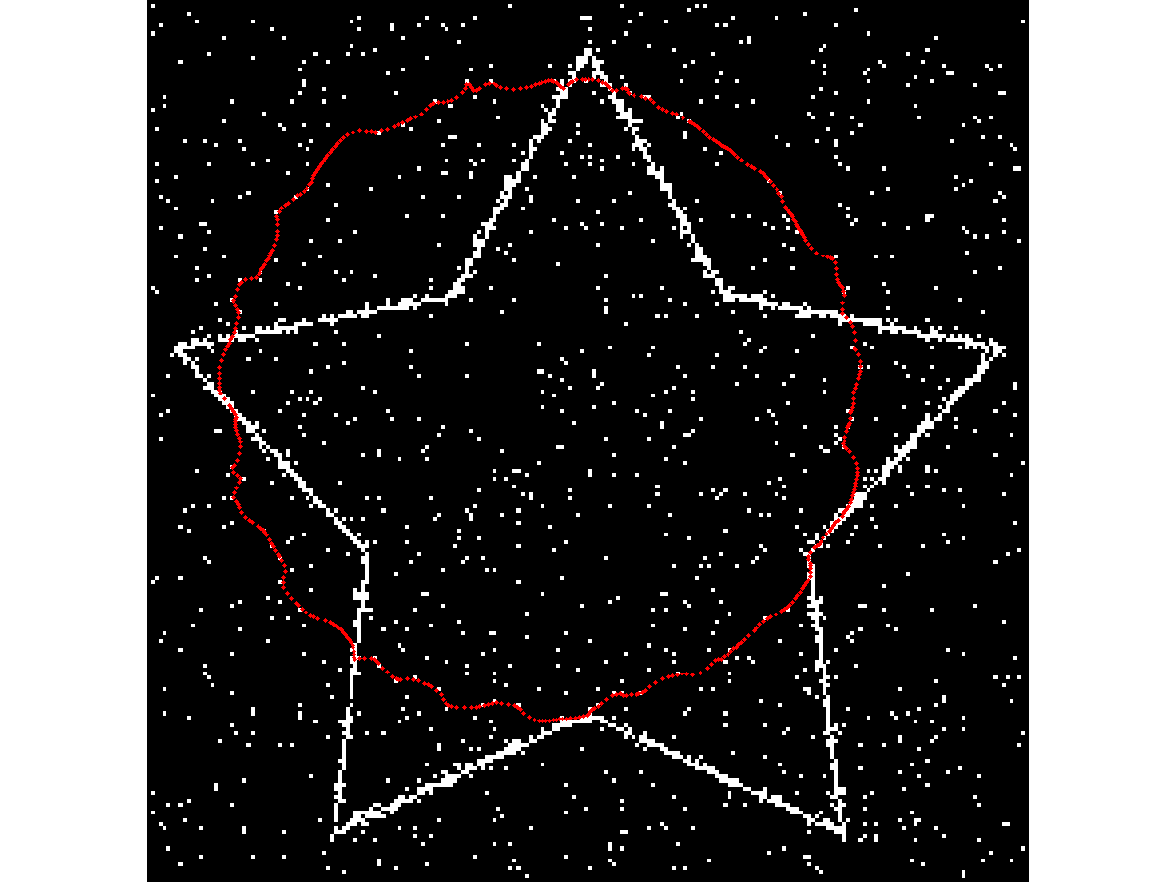
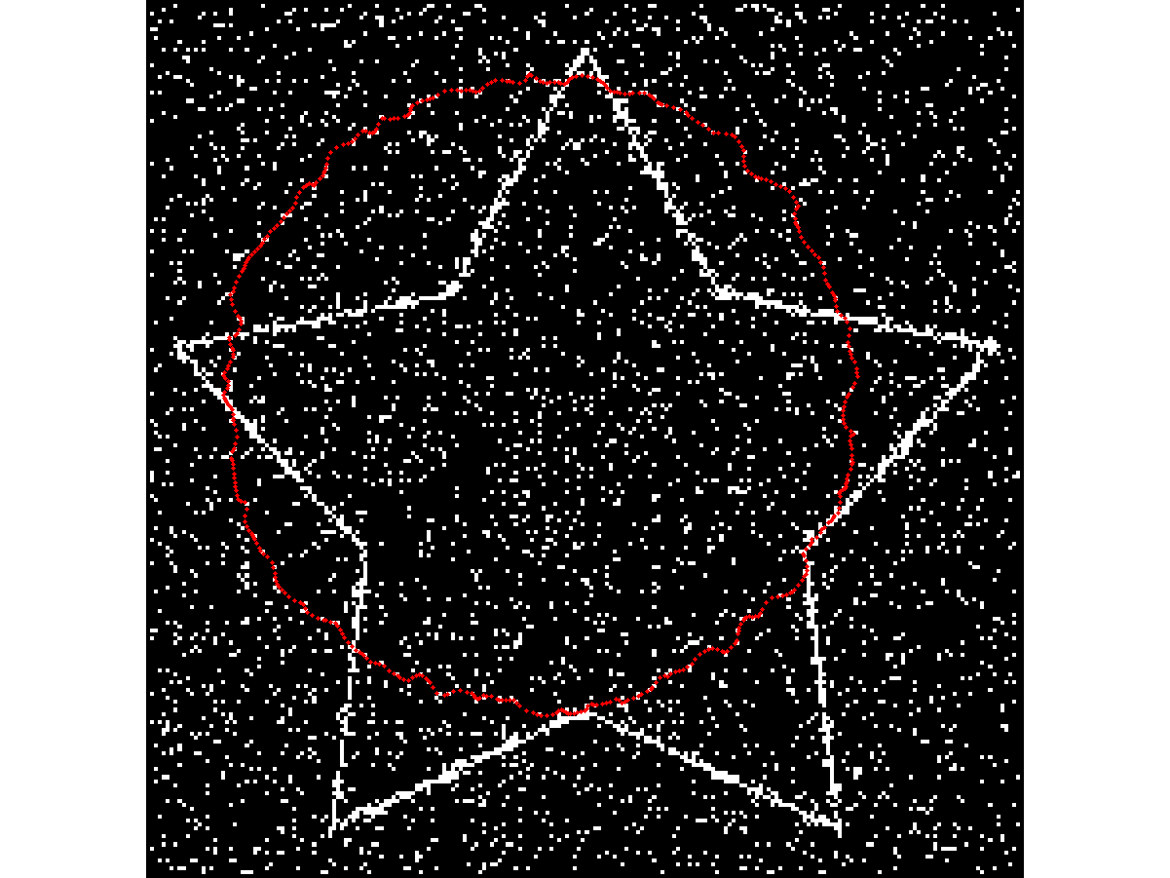
Robustness to noise : GVF with salt&pepper noise
1%
5%
15%

Slide 14
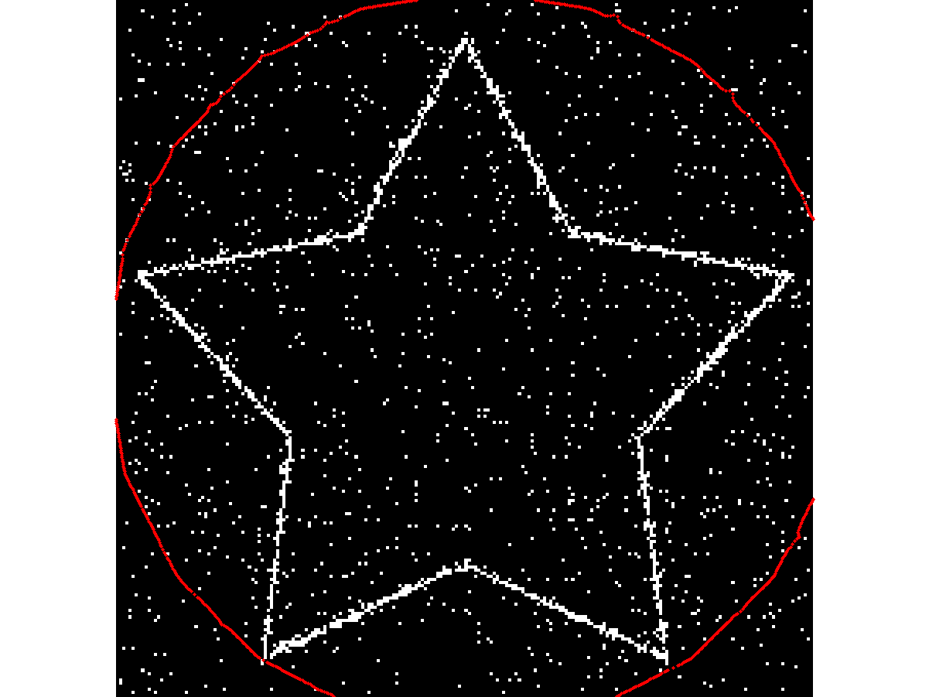
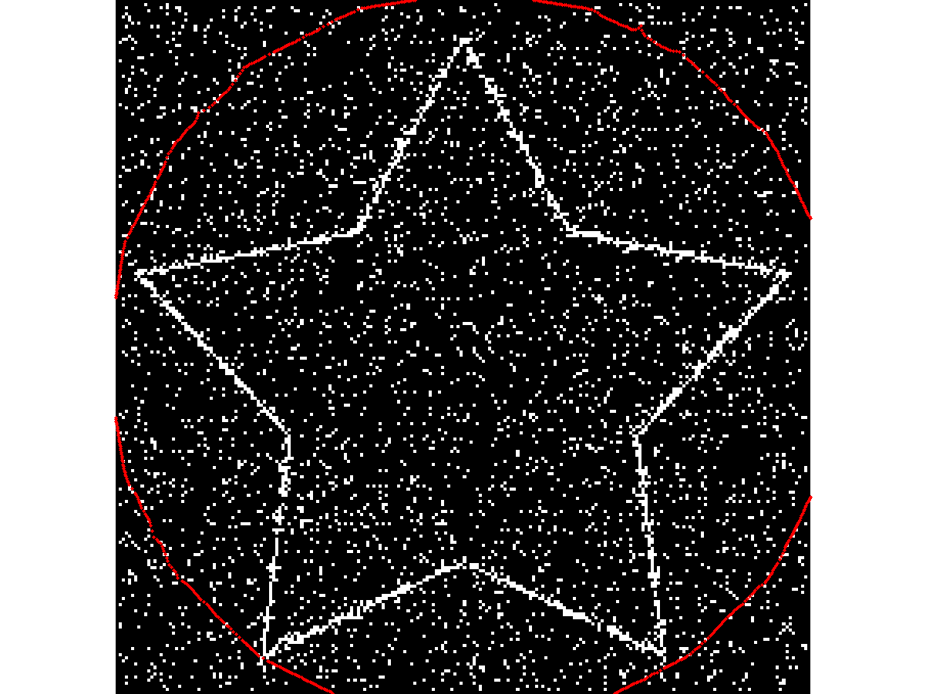
Robustness to noise : VFC with salt&pepper noise
5%
15%

Slide 15
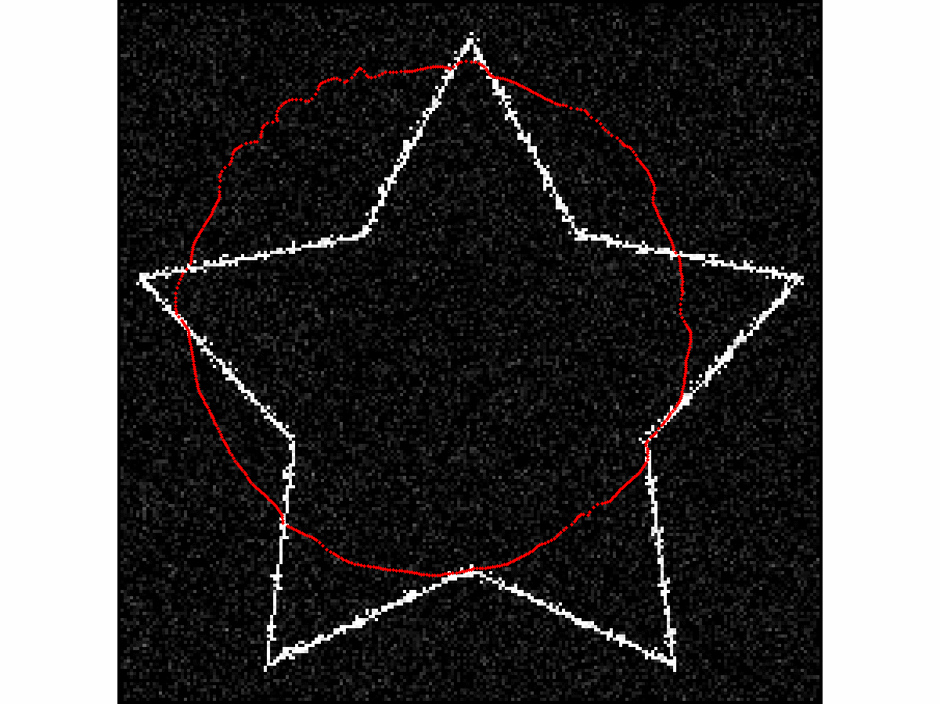
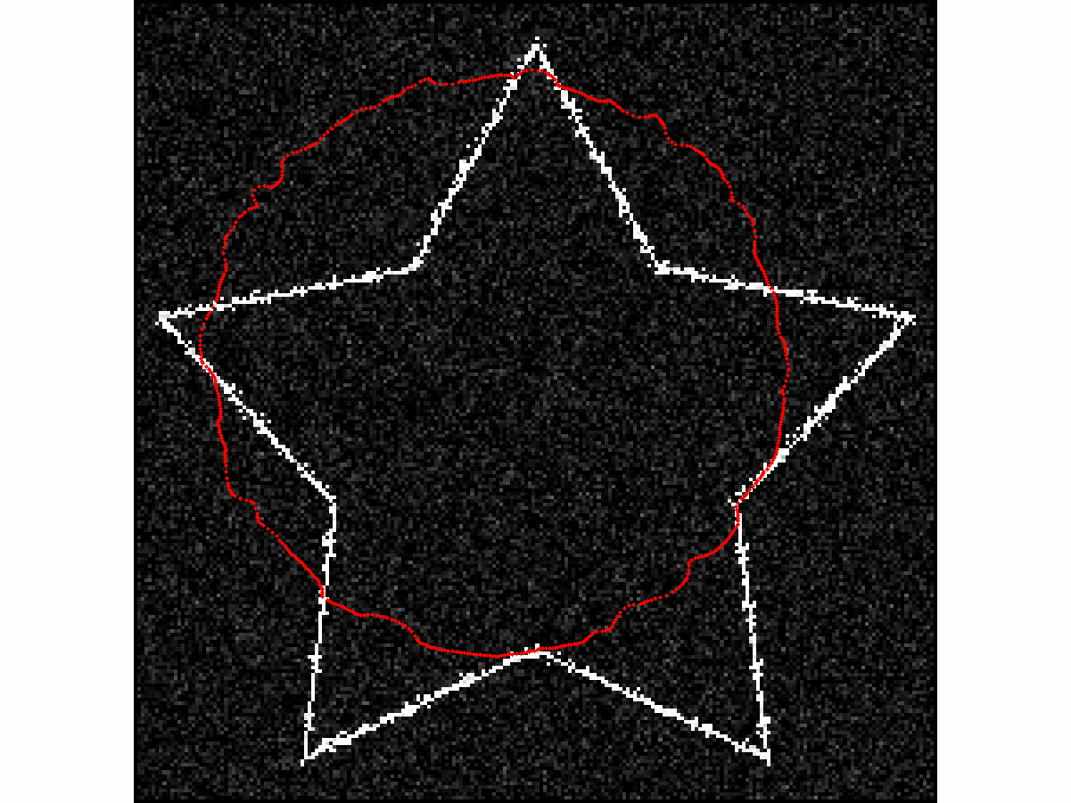
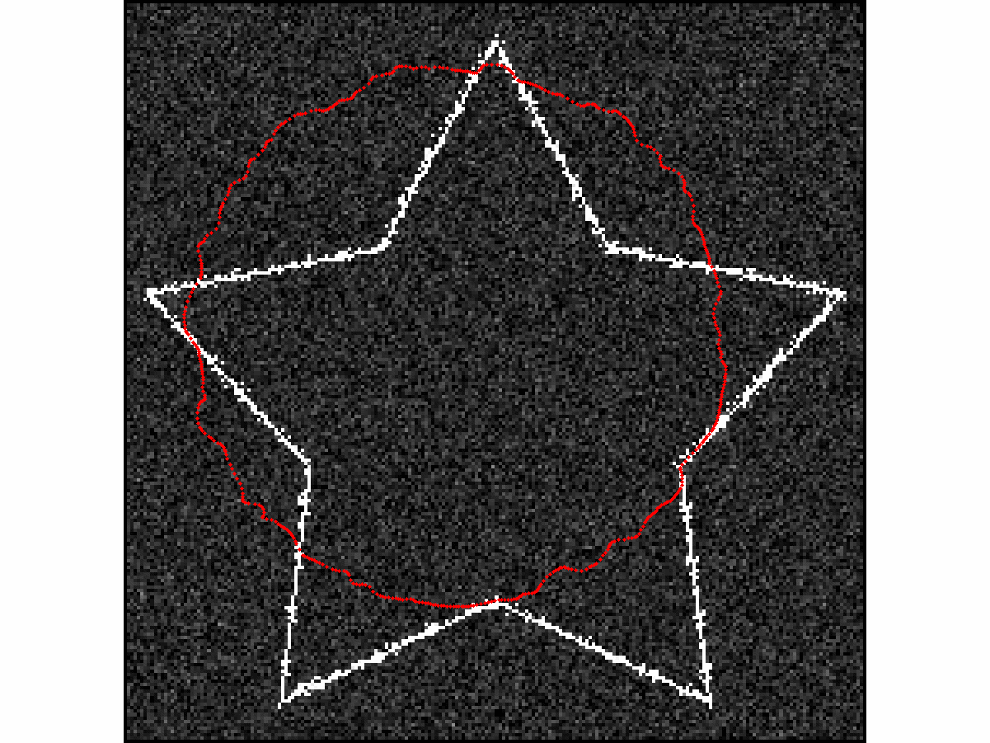
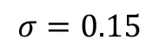
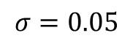
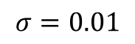
Robustness to noise : GVF with additive gaussian noise
$$σ=0.01$$
$$σ=0.05$$
$$σ=0.15$$

Slide 16
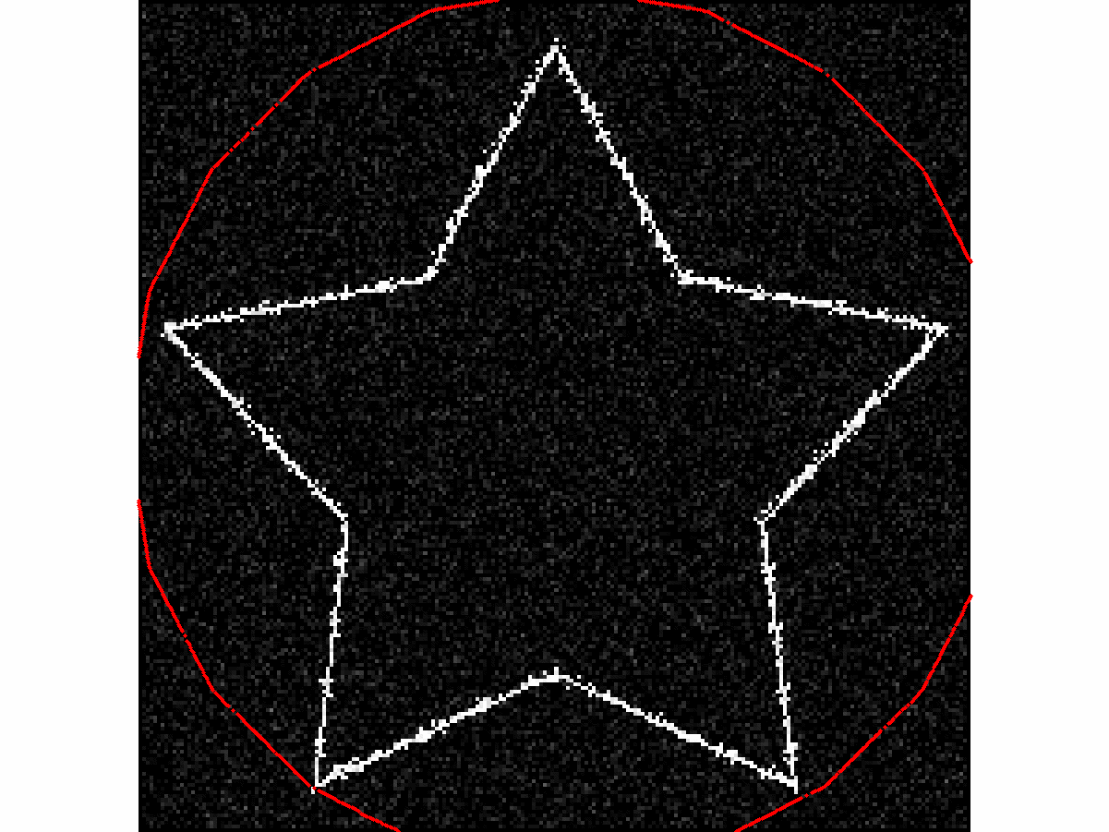
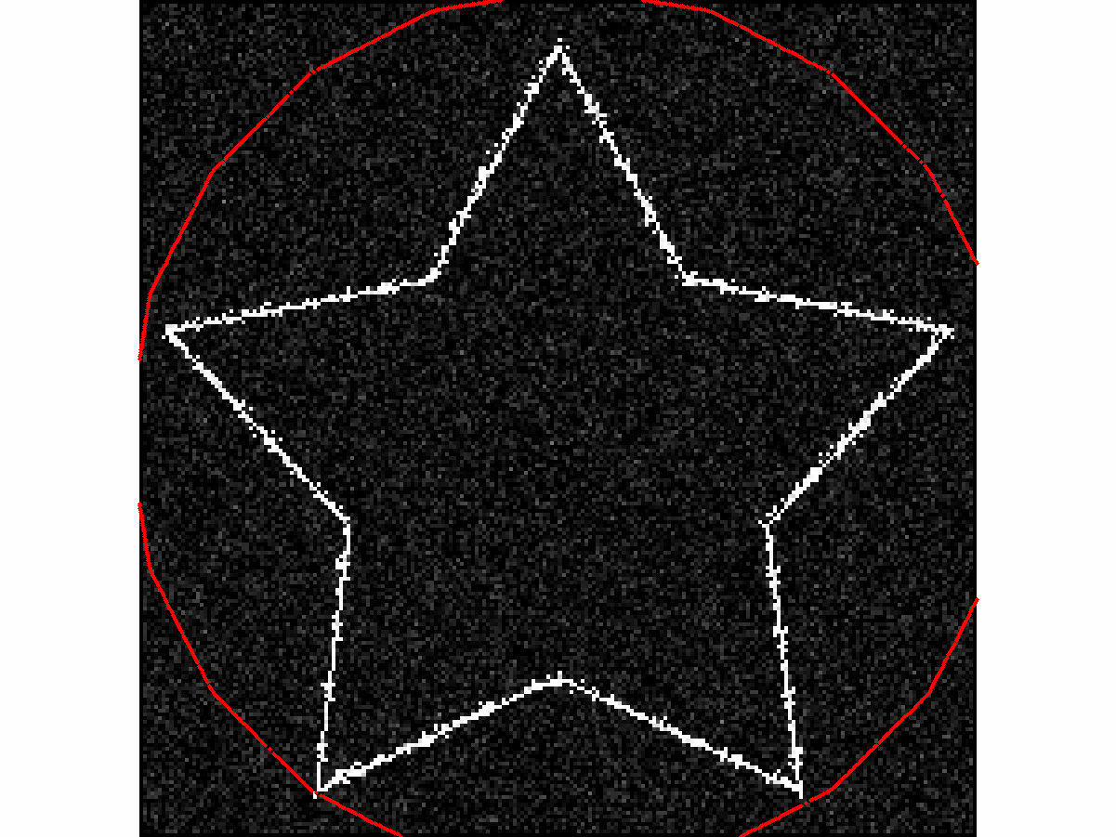




Robustness to noise : VFC with gaussian noise
$$σ=0.01$$
$$σ=0.05$$
$σ=0.$15

Slide 17



Robustness to noise : impact of the kernel radius ?
$$σ=0.15, R=128$$
$$σ=0.15, R=64$$

Slide 18

Conclusion
Capture range definition has been improved
Concavities converge property conserved
Better computational time
Better robustness to noise compared to GVF

Slide 19

Conclusion
Capture range definition has been improved
Concavities converge property conserved
Better computational time
Better robustness to noise compared to GVF

Slide 20
Further work
Adaptative kernel
In time
With respect to the data
Multi-scale VFC to handle noise

